Slide 1
Problem Statement
A consultation firm that works on analysing a brand’s presence on social media, or the effect of a marketing campaign of social media.
We are provided twitter data on an event conducted by SXSW of the year 2011. The brand would like to know the sentiments associated with the event.
Analysing the sentiments associated to a brand helps them in resolving the current issues and make better decisions.

Slide 2
PRE-PROCESSING & CLEANING
Noise | Treatment
User mentions | User mentions with @ were removed
HTML characters such as “&lt”,”&gt” | Converted to their appropriate signs “<”, “>”
Emojis :) :( | Converted to words such as happy,sad,etc..
URLs and links | Removed (only 3% at most tweets has URLs)
Abbreviations (b4, gr8) | Converted to full forms
Non-ASCII characters | Removed
Long words such as wooooww, fuunnyyy | Corrected to their proper forms wow, funny
Stop words and punctuations | Removed

Slide 3
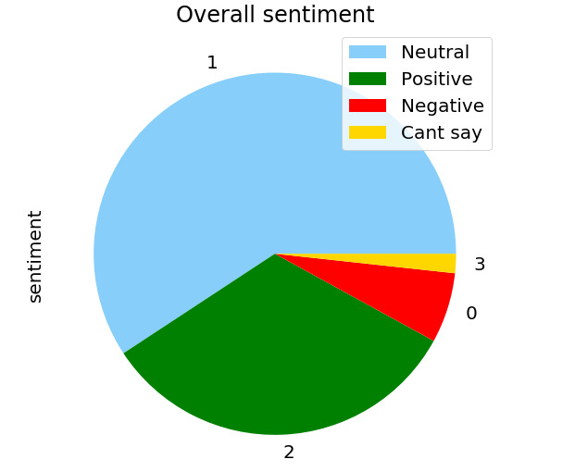
OVERALL SENTIMENT OF THE EVENT
The event overall had neutral to positive impact

Slide 4
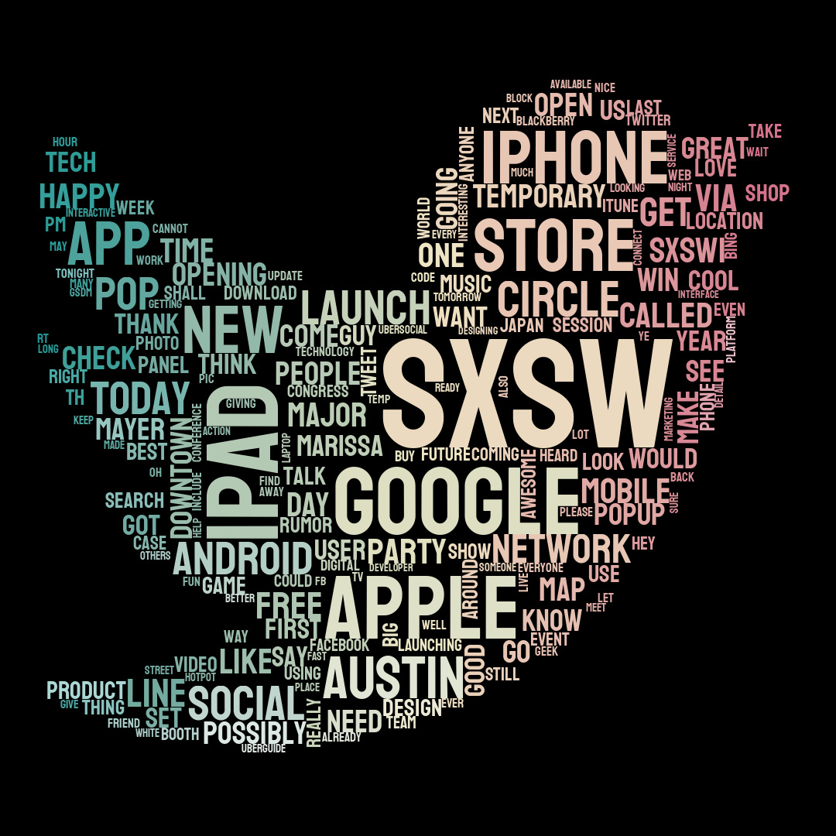

Slide 5
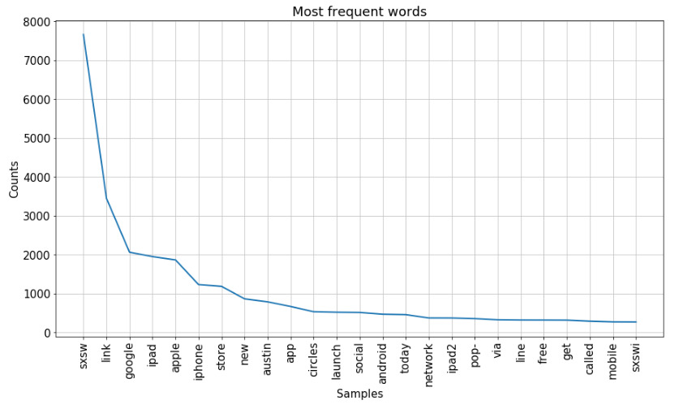
Frequently used words

Slide 6
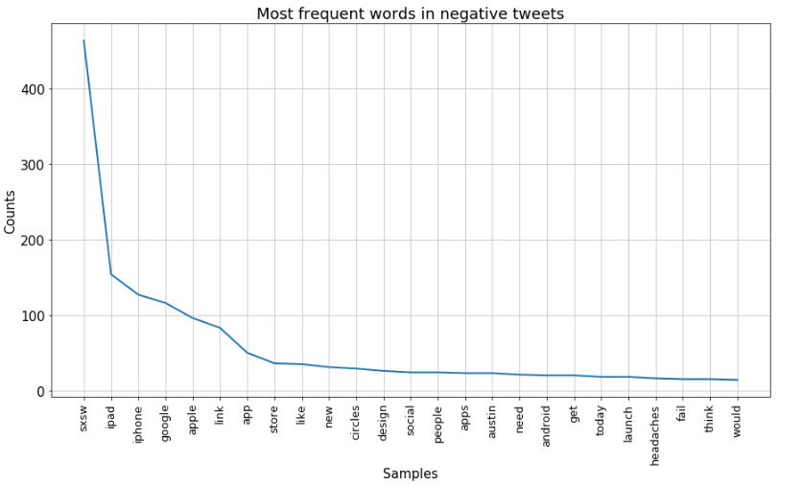
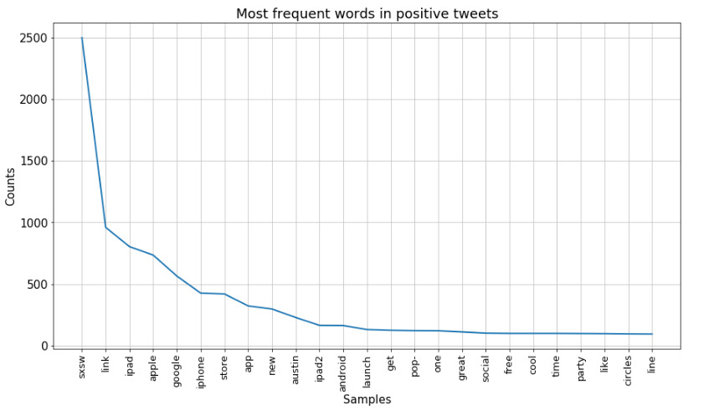
Frequently used words According to the Sentiment

Slide 7
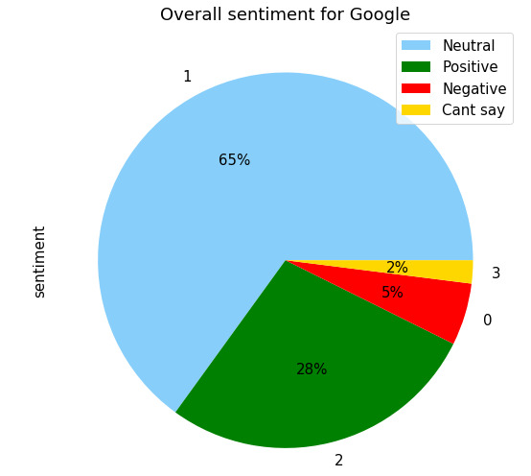
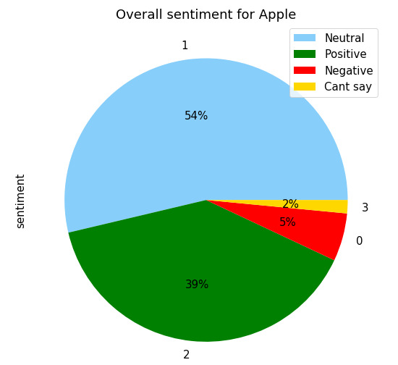
Brand vs Brand

Slide 8
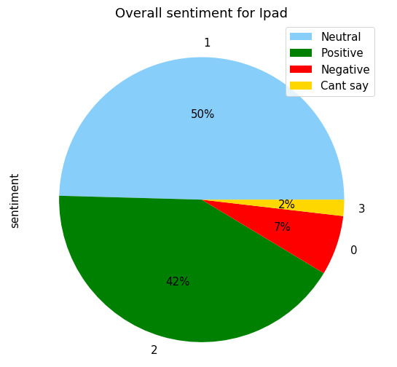
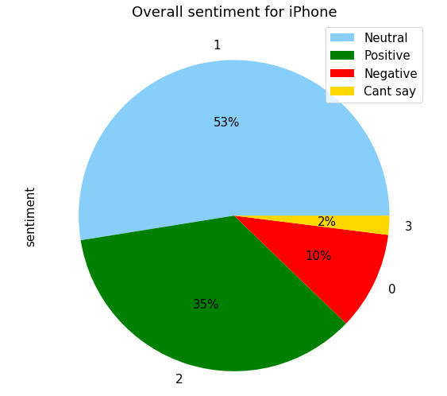
Product vs Product

Slide 9
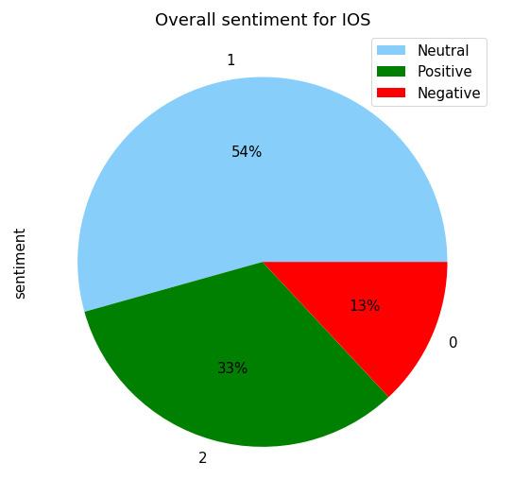
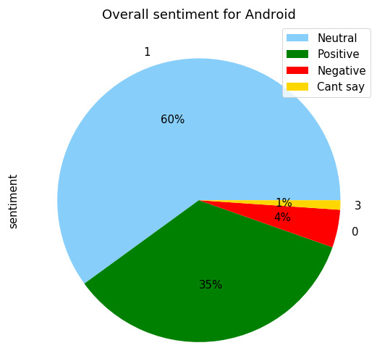
The Battle of Operating Systems
ANDROID DOMINATES

Slide 10
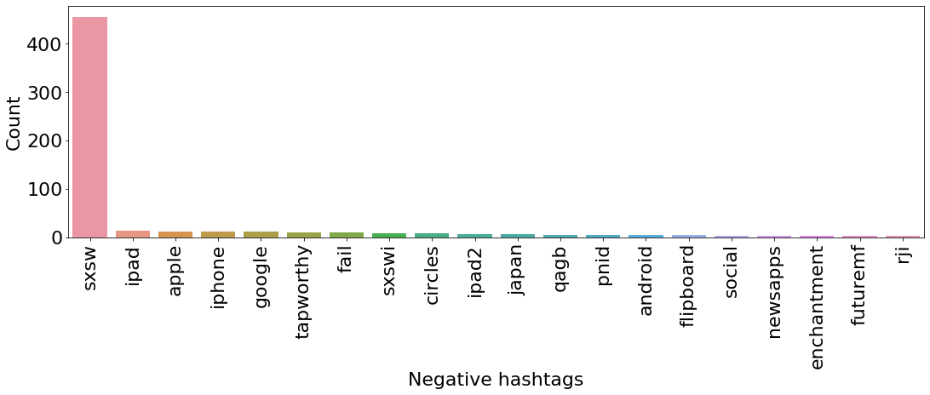
MOST FREQUENT NEGATIVE HASHTAGS

Slide 11
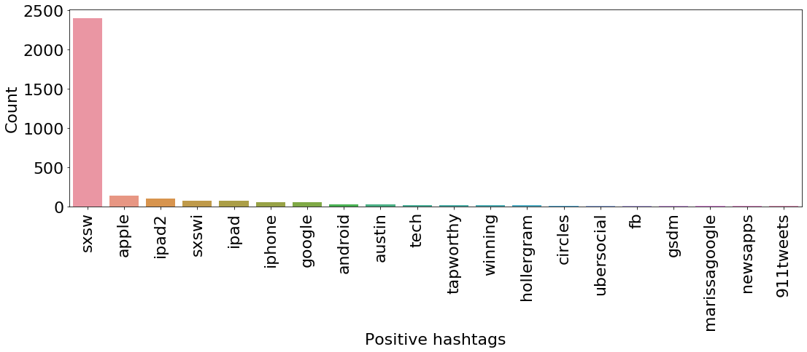
MOST FREQUENT POSITIVE HASHTAGS

Slide 12
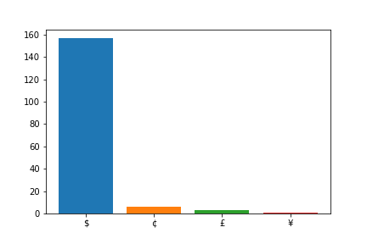
LOCATIONS IN TWEETS
Currencies mentioned in tweets

Slide 13
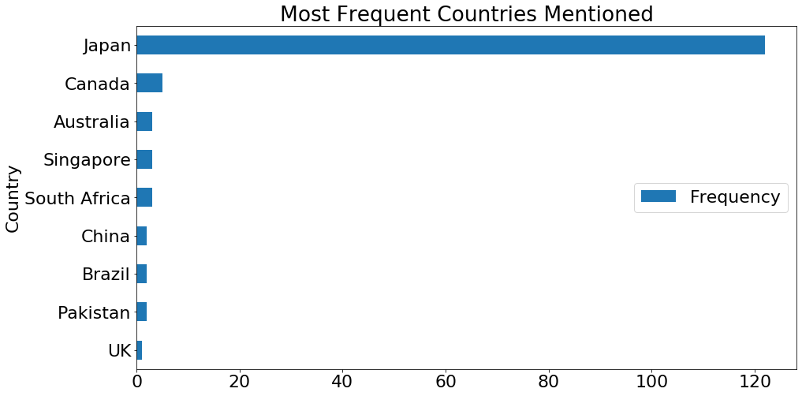
LOCATIONS IN TWEETS

Slide 14
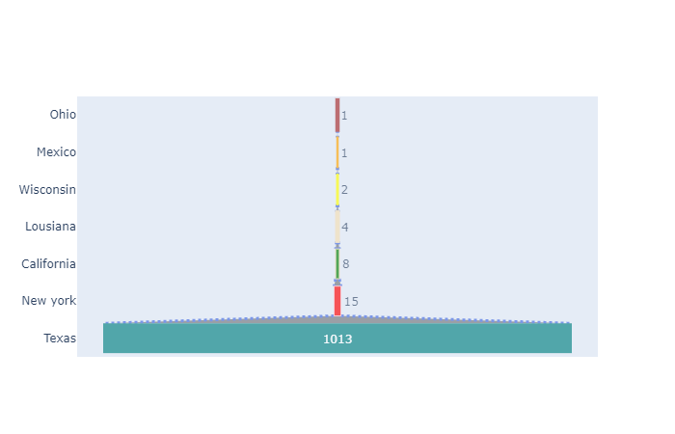
States of US mentioned in the tweets

Slide 15
Facts and Tidbits from the Tweets
18% of the tweets comprises of Questions. Some top questions are:
a)Anyone at #sxsw want an iPad 2?
b)I'm in line and will pick one up for someone willing to pay me 50 for me to grab 1 for you?
c)does anyone know if google did talk about #circles at #SXSW ?
The Dataset provided to us is from 2011
Top URLS mentioned in the tweets were
a)Registration page of SXSW
b) Candidly Christen website/Blog

Slide 16

CONTD
4) AT the event Google launched “CIRCLES” a.k.a GOOGLE+
5)Event took place in Austin,Texas
6)Apple opened a POP-UP store in Austin
7) This event marks the 25th anniversary of SXSW

Slide 17
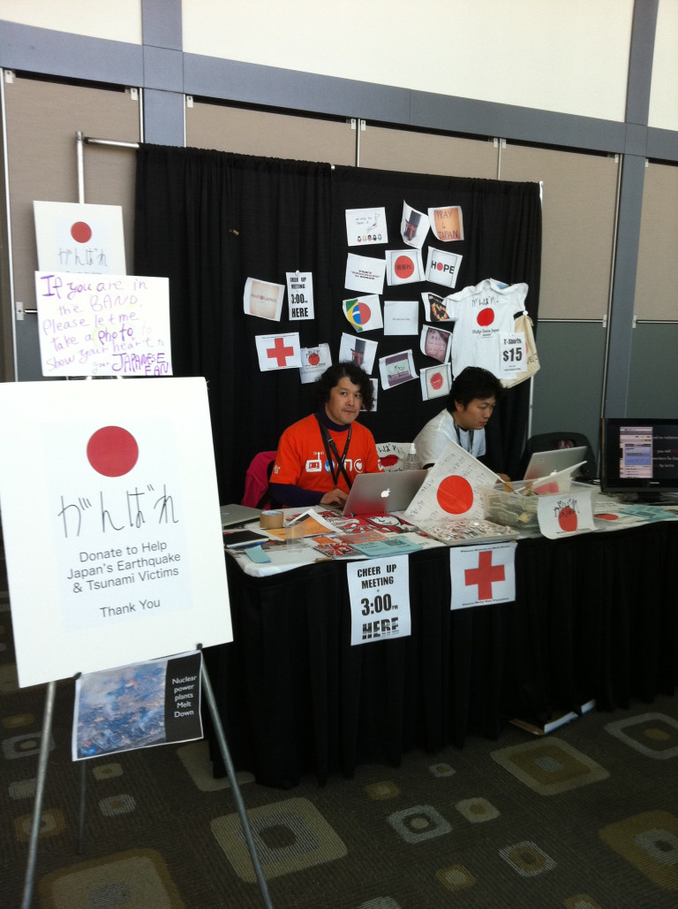
#SXSWCARES
NATURAL DISASTER like Earthquake and Tsunami occured in JAPAN during the sxsw event.
#sxswcares raised over 1 million and donated to Japan
Due to this Negative sentiment took a rise for IPAD.

Slide 18

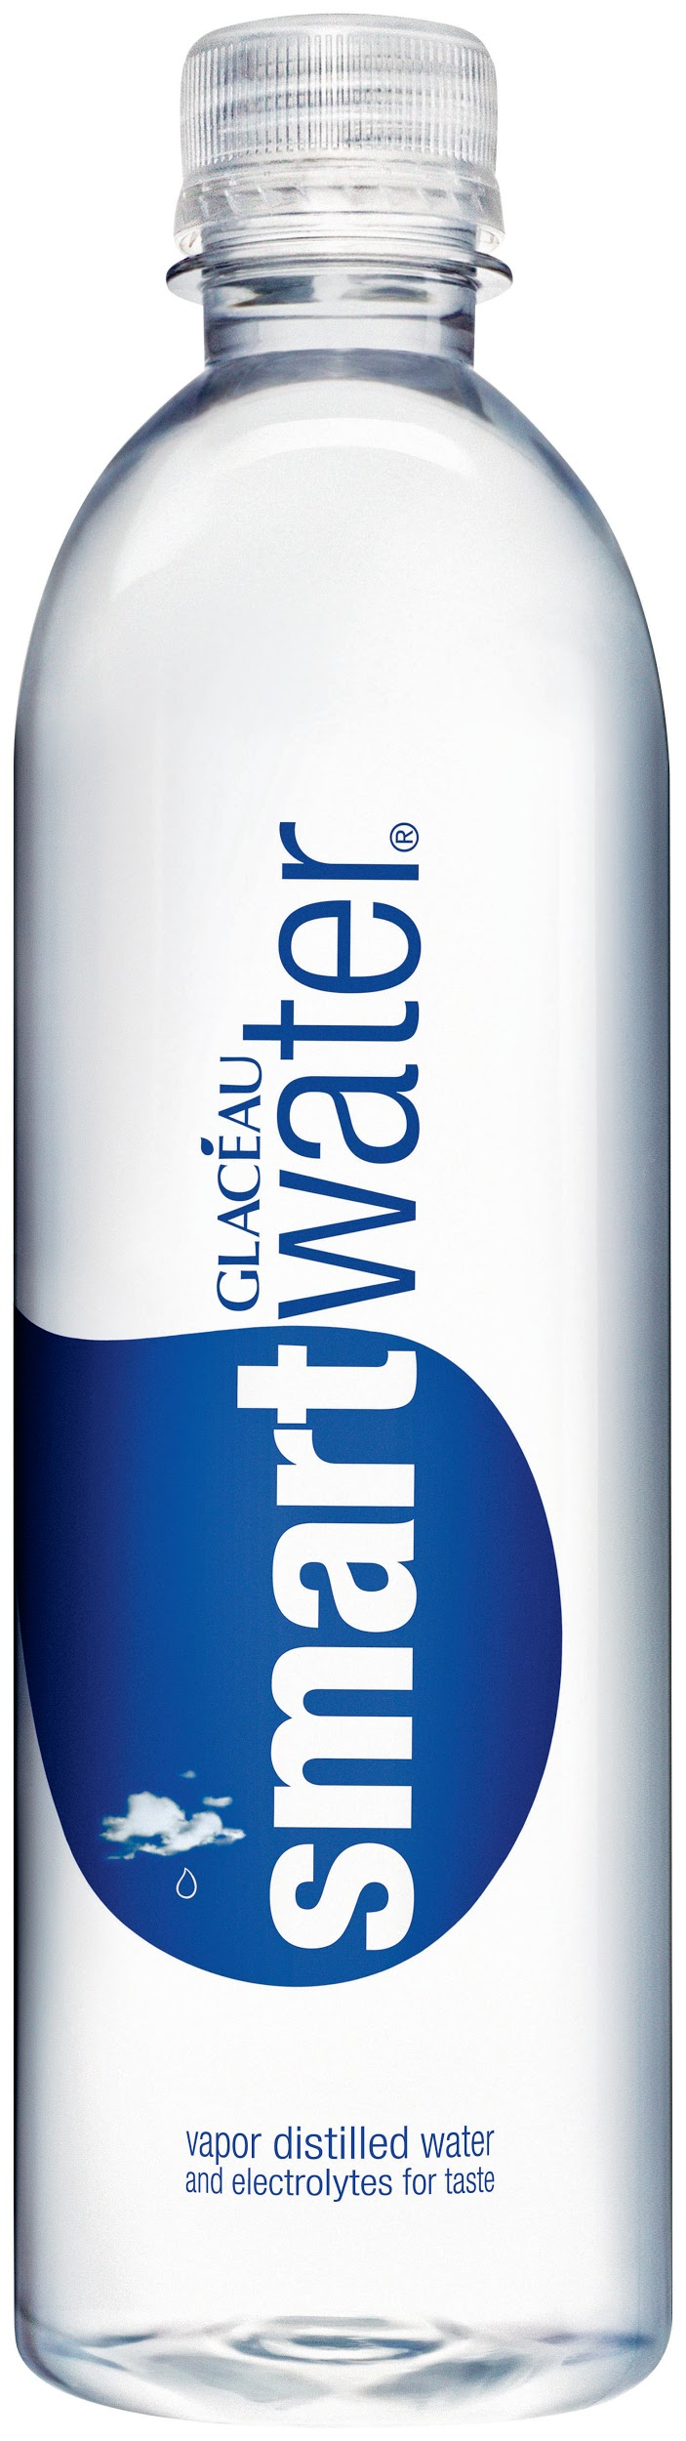





SPONSORED BY

Slide 19
MODELS TRAINING AND TESTING
Model | Technique | Train F1 Score | Test F1 score
Logistic Regression | Count Vector | 0.65 | 0.68
Logistic Regression | Count Vector + Stemming | 0.64 | 0.66
Logistic Regression | Count Vector + Lemmatization | 0.64 | 0.66
Logistic Regression | TFIDF | 0.64 | 0.65
Logistic Regression | TFIDF + Lemmatization | 0.62 | 0.65
SVC Pipeline | TFIDF + Lemmatization | 0.65 | 0.68
Gaussian Naive Bayes | Count Vector | 0.49 | 0.47

Slide 20
MODELS TRAINING AND TESTING
Model | Technique | Train F1 Score | Test F1 score
Decision Tree | Count Vector | 0.65 | 0.63
Random Forest | Count Vector | 0.65 | 0.63
Logistic Regression | Count Vector + Random Oversampling | 0.85 | 0.65
Logistic Regression | Count Vector + NGrams + Random Oversampling | 0.87 | 0.67
Logistic Regression | Count Vector + SMOTE | 0.83 | 0.64
SVC Pipeline | Count Vector + Random Oversampling | 0.85 | 0.67
XGBoost | With Hyperparameter Tuning + Random Oversampling | 0.84 | 0.66

Slide 21
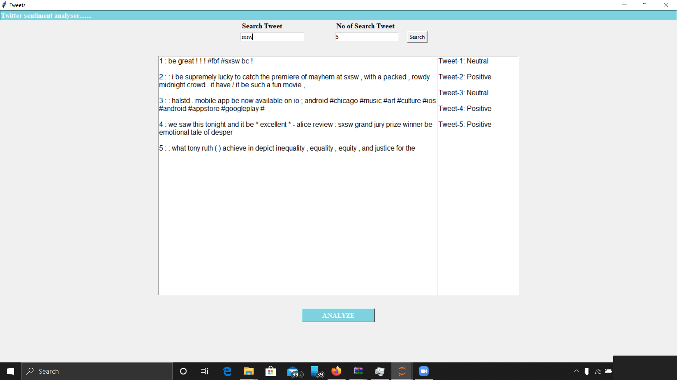
UI SCREENSHOT

Slide 22
CEO DESK
The event overall had a positive and neutral impact.
With the model built we can perform real time management of inadequacies happening during the event.
There was a slight negative impact due to earthquake happened in Japan.
We can perform trend analysis if date of the tweets are provided.
Market small promising brands more.

